Slide 1
Chapter 6: Formal Relational Query Languages
Notes:
‹#›

Slide 2
Chapter 6: Formal Relational Query Languages
Relational Algebra
Tuple Relational Calculus
Domain Relational Calculus
Notes:
‹#›

Slide 3
Relational Algebra
Procedural language
Six basic operators
select: σ (Sigma)
project: ∏ (Pi)
union: ∪
set difference: –
Cartesian product: x
rename: ρ (Rho)
Notes:
‹#›

Slide 4
Relational Algebra
The operators take one or two relations as inputs and produce a new relation as a result
Fundamental and Unary operators
select: σ (Sigma)
project: ∏ (Pi)
rename: ρ (Rho)
Fundamental and Binary operators
union: ∪
set difference: –
Cartesian product: x
Notes:
‹#›

Slide 5
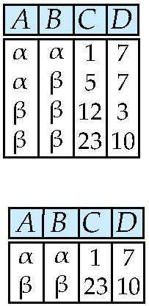
Select Operation – Example
Relation r
σ_{A=B ^ D > 5} (r)
Select the rows where
A and B are same
And
Also D > 5
Notes:
‹#›

Slide 6
Select Operation – Example
Relation r
σ_{A=B ^ D > 5} (r)
Notes:
‹#›

Slide 7
Select Operation
σ Unary operator
Notation: σ _{p}(r)
p is called the selection predicate
Defined as: σ_{p}(r) = {t | t ∈ r and p(t)}
Where p is a formula in propositional calculus consisting of terms connected by : ∧ (and), ∨ (or), ¬ (not) Each term is one of:
<attribute> op <attribute> or <constant>
where op is one of: =, ≠, >, ≥. <. ≤
Example of selection: σ _{dept_name=“Physics”}(instructor)
Notes:
‹#›

Slide 8
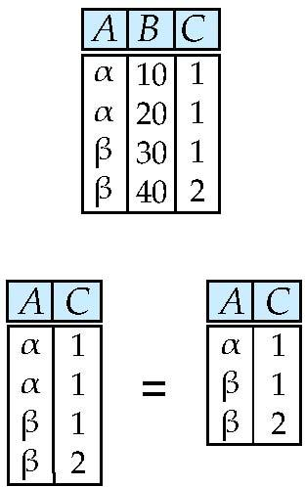
Project Operation – Example
Relation r:
∏_{A,C} (r)
Notes:
‹#›

Slide 9
Project Operation – Example
Relation r:
∏_{A,C} (r)
Notes:
‹#›

Slide 10
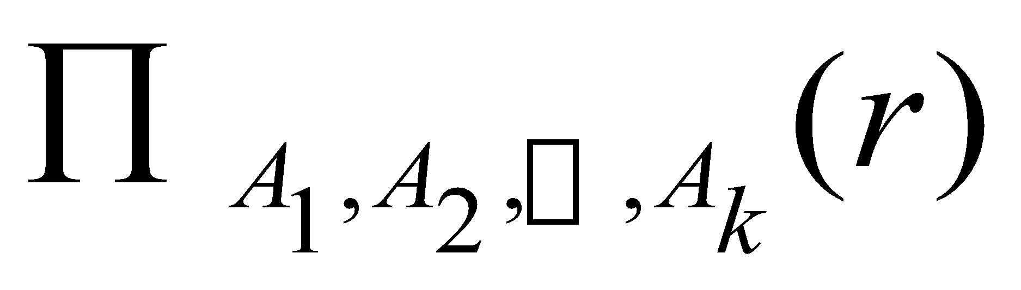
Project Operation
∏ Unary Operator
Notation:
where A₁, A₂ are attribute names and r is a relation name.
The result is defined as the relation of k columns obtained by erasing the columns that are not listed
Duplicate rows are removed from result, since relations are sets
Example: To eliminate the dept_name attribute of instructor ∏_{ID, name, salary} (instructor)
Notes:
‹#›

Slide 11
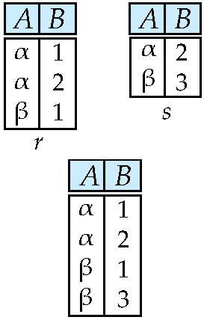
Union Operation – Example
Relations r, s:
r ∪ s:
Notes:
‹#›

Slide 12
Union Operation – Example
Relations r, s:
r ∪ s:
Notes:
‹#›

Slide 13
Union Operation
∪ Binary Operator
Notation: r ∪ s
Defined as:
r ∪ s = {t | t ∈ r or t ∈ s}
For r ∪ s to be valid.
1. r, s must have the same arity (same number of attributes)
2. The attribute domains must be compatible (example: 2nd column of r deals with the same type of values as does the 2nd column of s)
Example: to find all courses taught in the Fall 2009 semester, or in the Spring 2010 semester, or in both ∏_{course_id} (σ _{semester=“Fall” Λ year=2009} (section)) ∪ ∏_{course_id} (σ _{semester=“Spring” Λ year=2010} (section))
Notes:
‹#›

Slide 14
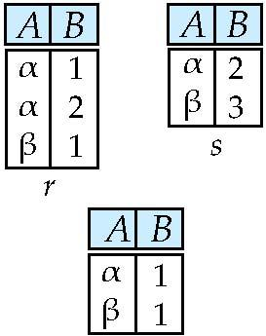
Set difference of two relations
Relations r, s:
r – s:
Notes:
‹#›

Slide 15
Set difference of two relations
Relations r, s:
r – s:
Notes:
‹#›

Slide 16
Set Difference Operation
‘-’ Binary Operator
Notation r – s
Defined as:
r – s = {t | t ∈ r and t ∉ s}
Set differences must be taken between compatible relations.
r and s must have the same arity
attribute domains of r and s must be compatible
Example: to find all courses taught in the Fall 2009 semester, but not in the Spring 2010 semester ∏_{course_id} (σ _{semester=“Fall” Λ year=2009} (section)) − ∏_{course_id} (σ _{semester=“Spring” Λ year=2010} (section))
Notes:
‹#›

Slide 17
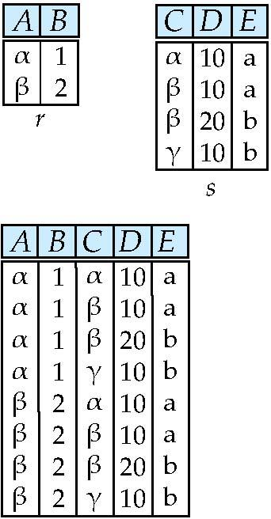
Cartesian-Product Operation – Example
Relations r, s:
r x s:
Notes:
‹#›

Slide 18
Cartesian-Product Operation – Example
Relations r, s:
r x s:
Notes:
‹#›

Slide 19
Cartesian-Product Operation
‘X’ Binary Operator
Notation r x s
Defined as:
r x s = {t q | t ∈ r and q ∈ s}
Assume that attributes of r(R) and s(S) are disjoint (i.e., R ∩ S = ∅)
If attributes of r(R) and s(S) are not disjoint, then renaming must be used
Notes:
‹#›

Slide 20
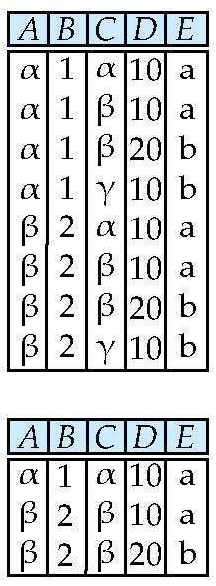

Composition of Operations
Can build expressions using multiple operations
Example: σ_{A=C}(r x s)
r x s
σ_{A=C}(r x s)
Notes:
‹#›

Slide 21
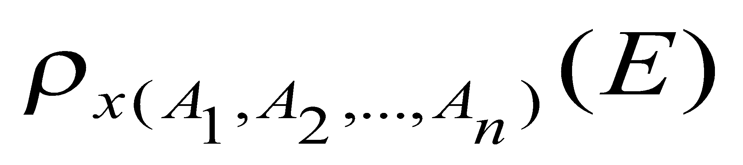
Rename Operation
‘ρ ‘ Unary Operator
Allows us to name, and therefore to refer to, the results of relational-algebra expressions
Allows us to refer to a relation by more than one name
Example:
ρ _{x} (E)
returns the expression E under the name X
If a relational-algebra expression E has arity n, then
returns the result of expression E under the name X, and with the
attributes renamed to A₁ , A₂ , …., A_{n}
Notes:
‹#›

Slide 22
Example Query
Find the largest salary in the university
Step 1: find instructor salaries that are less than some other instructor salary (i.e. not maximum)
using a copy of instructor under a new name d
∏_{instructor.salary} (σ _{instructor.salary < d.salary} (instructor x ρ_{d} (instructor)))
Step 2: Find the largest salary
∏_{salary} (instructor) – ∏_{instructor.salary} (σ _{instructor.salary < d.salary} (instructor x ρ_{d} (instructor)))

Slide 23
Example Queries
Find the names of all instructors in the Physics department, along with the course_id of all courses they have taught
Query 1 ∏_{instructor.ID,course_id} (σ_{dept_name=“Physics”} ( σ _{instructor.ID=teaches.ID} (instructor x teaches)))
Query 2 ∏_{instructor.ID,course_id} (σ_{instructor.ID=teaches.ID} ( σ _{dept_name=“Physics”} (instructor) x teaches))
Notes:
‹#›

Slide 24
Formal Definition
A basic expression in the relational algebra consists of either one of the following:
A relation in the database
A constant relation
Let E₁ and E₂ be relational-algebra expressions; the following are all relational-algebra expressions:
E₁ ∪ E₂
E₁ – E₂
E₁ x E₂
σ_{p} (E₁), P is a predicate on attributes in E₁
∏_{s}(E₁), S is a list consisting of some of the attributes in E₁
ρ _{x} (E₁), x is the new name for the result of E₁
Notes:
‹#›

Slide 25
Additional Operations
Additional operations that do not add any power to the relational algebra, but that simplify common queries
Whenever it is used, utilizes basic operations
Set intersection
Assignment
Join
Notes:
‹#›

Slide 26
Set-Intersection Operation
Notation: r ∩ s
Defined as:
r ∩ s = { t | t ∈ r and t ∈ s }
Assume:
r, s have the same arity
attributes of r and s are compatible
Note: r ∩ s = r – (r – s)
Notes:
‹#›

Slide 27
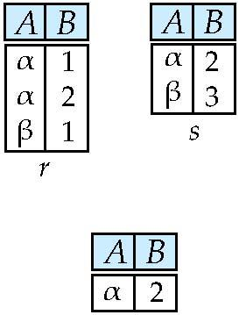
Set-Intersection Operation – Example
Relation r, s:
r ∩ s
Notes:
‹#›

Slide 28
Assignment Operation
The assignment operation (←) provides a convenient way to express complex queries
Write query as a sequential program consisting of
a series of assignments
followed by an expression whose value is displayed as a result of the query
Assignment must always be made to a temporary relation variable
Notes:
‹#›

Slide 29
Join Operation
Cartesian Product of two relation
Gives all the possible tuples that are paired together
Also called cross join
But it might NOT be feasible for
Huge relations where number of tuples are in thousands and
Attributes of both relations are considerable large
Join Operation
Combination of Cartesian product followed by selection process
Join operation pairs two tuples from different relations if and only if the given join condition is satisfied
Types
Inner Join (Theta Join, Equi Join, Natural Join)
Outer Join (Left outer Join, Right outer Join, Full outer Join)

Slide 30
Cartesian-Product Operation – Example
Relations r, s:
r x s:
Notes:
‹#›

Slide 31
Inner Join
An inner-join process includes only tuples with matching attributes, rest are discarded in resulting relation
Theta Join
Equi Join
Natural Join

Slide 32
Theta (θ) Join
θ in Theta join is the join condition
Combines tuples from different relations provided they satisfy the theta condition
R1 ⋈_{θ} R2
R1 and R2 are relations with their attributes (A1, A2, .., An ) and (B1, B2,.. ,Bn) such that NO Attribute matches that is R1 ∩ R2 = Φ
Theta join can use all kinds of comparison operators
The theta join operation r _{θ} s is defined as
r _{θ} s = σ_{θ} (r x s)

Slide 33
Theta (θ) Join
Subjects
Student
Class | Subject
10 | Math
10 | English
11 | Music
11 | Sports
SID | Name | Std
101 | Alex | 10
102 | Maria | 11
STUDENT ⋈_{Student.Std = Subject.Class} SUBJECT
SID | Name | Std | Class | Subject
101 | Alex | 10 | 10 | Math
101 | Alex | 10 | 10 | English
102 | Maria | 11 | 11 | Music
102 | Maria | 11 | 11 | Sports

Slide 34
Equi Join
When Theta join uses only equality comparison operator it is said to be Equi-Join
The early example conrresponds to equi join

Slide 35
Natural Join
Does not use any comparison operator
Does not concatenate the way Cartesian product does
Instead, Natural Join can only be performed if the there is at least one common attribute exists between relation
Those attributes must have same name and domain
Acts on those matching attributes where the values of attributes in both relation is same

Slide 36
Natural Join Operation
Notation: r s
Let r and s be relations on schemas R and S respectively Then, r s is a relation on schema R ∪ S obtained as follows:
Consider each pair of tuples t_{r} from r and t_{s} from s
If t_{r} and t_{s} have the same value on each of the attributes in R ∩ S, add a tuple t to the result, where
t has the same value as t_{r} on r
t has the same value as t_{s} on s
Example:
R = (A, B, C, D)
S = (E, B, D)
Result schema = (A, B, C, D, E)
r s is defined as: ∏_{r.A, r.B, r.C, r.D, s.E} (σ_{r.B = s.B ∧ r.D = s.D} (r x s))
Notes:
‹#›

Slide 37
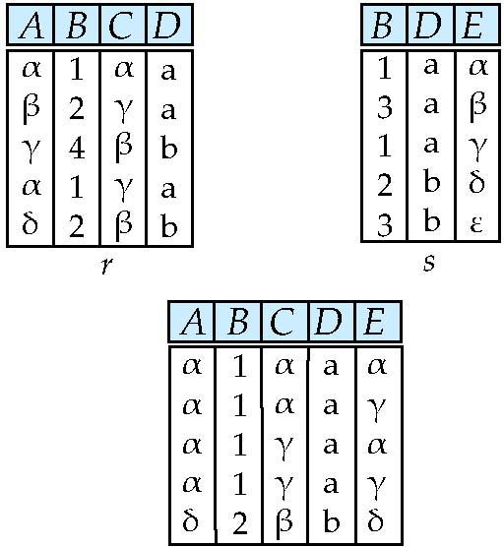
Natural Join Example
Relations r, s:
r s
Notes:
‹#›

Slide 38
Natural Join – Example
Relation instructor
Relation teaches
ID
name
dept_name
ID
course_id
10101
12121
15151
Srinivasan
Wu
Mozart
Comp. Sci.
Finance
Music
10101
12121
76766
CS-101
FIN-201
BIO-101
Join instructor teaches
ID
name
dept_name
course_id
10101
12121
Srinivasan
Wu
Comp. Sci.
Finance
CS-101
FIN-201
Notes:
‹#›

Slide 39
Natural Join
Find the names of all instructors in the Comp. Sci. department together with the course titles of all the courses that the instructors teach
∏ _{name, title} (σ _{dept_name=“Comp. Sci.”} (instructor teaches course))
Natural join is associative
(instructor teaches) course is equivalent to instructor (teaches course)

Slide 40
Exercise
Courses
HoD
CID | Course | Dept
CS01 | Database | CS
ME01 | Mechanics | ME
EE01 | Electronics | EE
Dept | Head
CS | Alex
ME | Maya
EE | Mira
Display all courses with their department Head names.
Courses ⋈ HoD
Dept | CID | Course | Head
CS | CS01 | Database | Alex
ME | ME01 | Mechanics | Maya
EE | EE01 | Electronics | Mira

Slide 41
If…
Courses
HoD
CID | Course | Dept
CS01 | Database | CS
ME01 | Mechanics | ME
EE01 | Electronics | EE
MU01 | MusicNotes | MU
Dept | Head
CS | Alex
ME | Maya
EE | Mira
FIN | XYZ
Display all courses with their department Head names.
Courses ⋈ HoD
Dept | CID | Course | Head
CS | CS01 | Database | Alex
ME | ME01 | Mechanics | Maya
EE | EE01 | Electronics | Mira
?

Slide 42
Outer Join
An extension of the join operation that avoids loss of information
Computes the join and then adds tuples from one relation that does not match tuples in the other relation to the resultant relation of the join
Uses null values:
null signifies that the value is unknown or does not exist
All comparisons involving null are (roughly speaking) false by definition
Outer join can be expressed using basic operations
e.g. r s can be written as
(r s) U (r – ∏_{R}(r s) x {(null, …, null)}
Notes:
‹#›

Slide 43
Outer Join – Example
Relation instructor
ID
name
dept_name
10101
12121
15151
Srinivasan
Wu
Mozart
Comp. Sci.
Finance
Music
Relation teaches
ID
course_id
10101
12121
76766
CS-101
FIN-201
BIO-101
Notes:
‹#›

Slide 44
Outer Join – Example
Relation instructor
Relation teaches
ID
name
dept_name
ID
course_id
10101
12121
15151
Srinivasan
Wu
Mozart
Comp. Sci.
Finance
Music
10101
12121
76766
CS-101
FIN-201
BIO-101
Natural Join instructor teaches
ID
name
dept_name
course_id
10101
12121
Srinivasan
Wu
Comp. Sci.
Finance
CS-101
FIN-201
Notes:
‹#›

Slide 45
Outer Join – Example
Relation instructor1
Relation teaches1
ID
name
dept_name
ID
course_id
10101
12121
15151
Srinivasan
Wu
Mozart
Comp. Sci.
Finance
Music
10101
12121
76766
CS-101
FIN-201
BIO-101
Join instructor teaches
ID
name
dept_name
course_id
10101
12121
Srinivasan
Wu
Comp. Sci.
Finance
CS-101
FIN-201
Left Outer Join
instructor teaches
select * from instructor left outer join teaches on instructor.ID = teaches.ID;
ID
name
dept_name
course_id
10101
12121
15151
Srinivasan
Wu
Mozart
Comp. Sci.
Finance
Music
CS-101
FIN-201
null
Notes:
‹#›

Slide 46
Outer Join – Example
Right Outer Join
instructor teaches
select * from instructor rightt outer join teaches on instructor.ID = teaches.ID;
ID
name
dept_name
course_id
10101
12121
76766
Srinivasan
Wu
null
Comp. Sci.
Finance
null
CS-101
FIN-201
BIO-101
Full Outer Join
instructor teaches
ID
name
dept_name
course_id
10101
12121
15151
76766
Srinivasan
Wu
Mozart
null
Comp. Sci.
Finance
Music
null
CS-101
FIN-201
null
BIO-101
Notes:
‹#›

Slide 47



Exercise
Courses
HoD
A | B
100 | Database
101 | Mechanics
102 | Electronics
A | C
100 | Alex
102 | Maya
104 | Mira
Courses HoD
Courses HoD
A | B | C
100 | Database | Alex
101 | Mechanics | null
102 | Electronics | Maya
A | B | C
100 | Database | Alex
102 | Electronics | Maya
104 | null | Mira
Courses HoD
Courses.A | Courses.B | HoD.A | HoD.C
100 | Database | 100 | Alex
101 | Mechanics | null | null
102 | Electronics | 102 | Maya
null | null | 104 | Mira

Slide 48
Exercise
Employee
Dept
Name | EmpId | DeptName
Harry | 3415 | Finance
Sally | 2241 | Sales
George | 3401 | Finance
Harriet | 2202 | Sales
DeptName | Manager
Finance | George
Sales | Harriet
Production | Charles
Employee Dept
Employee Dept
Name | EmpId | DeptName | Manager
Harry | 3415 | Finance | George
Sally | 2241 | Sales | Harriet
George | 3401 | Finance | George
Harriet | 2202 | Sales | Harriet
Employee Dept
Employee Dept

Slide 49
Extended Relational-Algebra-Operations
Generalized Projection
Aggregate Functions
Notes:
‹#›

Slide 50
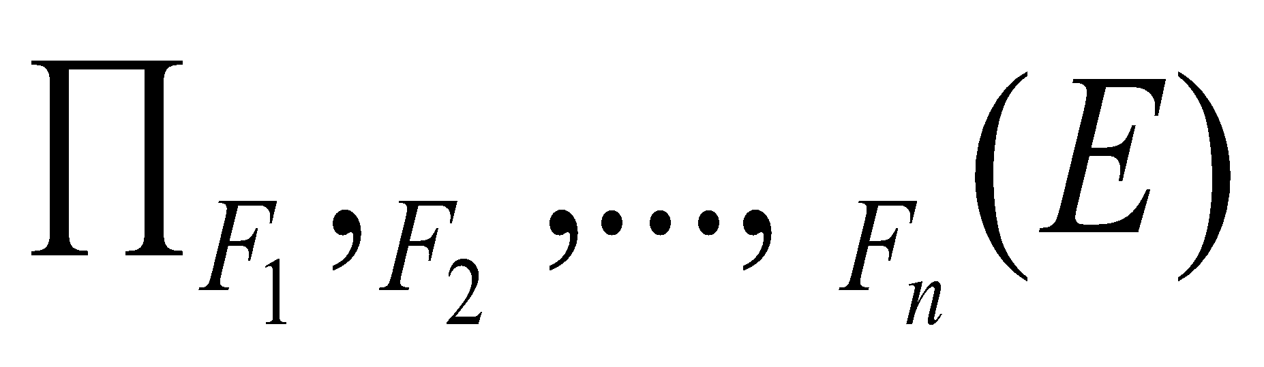
Generalized Projection
Extends the projection operation by allowing arithmetic functions to be used in the projection list.
E is any relational-algebra expression
Each of F₁, F₂, …, F_{n} are are arithmetic expressions involving constants and attributes in the schema of E.
Given relation instructor(ID, name, dept_name, salary) where salary is annual salary, get the same information but with monthly salary
∏_{ID, name, dept_name, salary/12} (instructor)
Notes:
‹#›

Slide 51
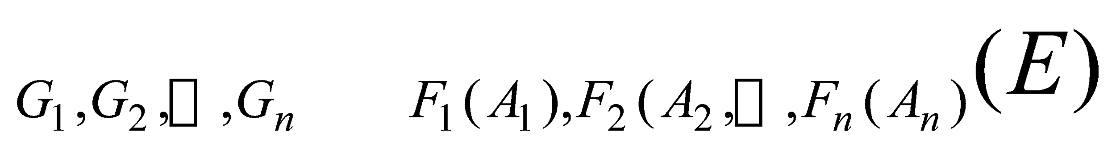

Aggregate Functions and Operations
Aggregation function takes a collection of values and returns a single value as a result
avg: average value min: minimum value max: maximum value sum: sum of values count: number of values
Aggregate operation in relational algebra
E is any relational-algebra expression
G₁, G₂ …, G_{n} is a list of attributes on which to group (can be empty)
Each F_{i} is an aggregate function
Each A_{i} is an attribute name
Note: Some books/articles use γ instead of (Calligraphic G)
Notes:
‹#›

Slide 52
Aggregate Operation – Example
Relation r:
A
B
C
α
α
β
β
α
β
β
β
7
7
3
10
_{sum(c)} (r)
sum(c )
27
Notes:
‹#›

Slide 53
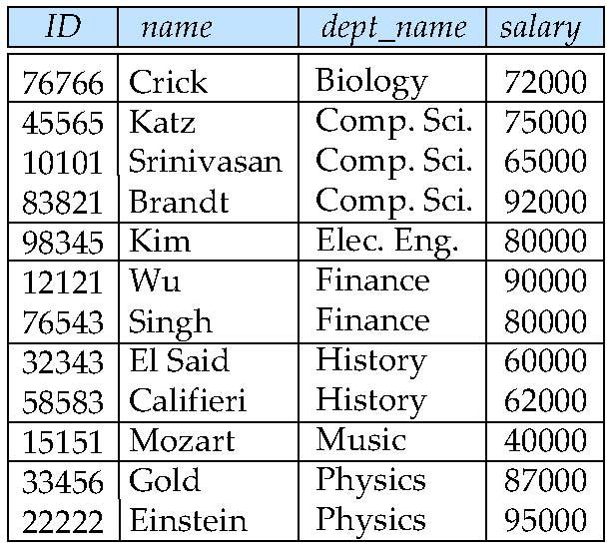
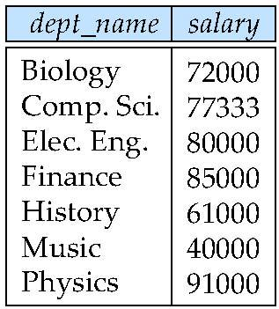
Aggregate Operation – Example
Find the average salary in each department
_{dept_name} _{avg(salary)} (instructor)
Notes:
‹#›

Slide 54
Aggregate Functions (Cont.)
Result of aggregation does not have a name
Can use rename operation to give it a name
For convenience, we permit renaming as part of aggregate operation
_{dept_name} _{avg(salary) as avg_sal} (instructor)
Notes:
‹#›

Slide 55
SQL and Relational Algebra
select A1, A2, .. An from r1, r2, …, rm where P
is equivalent to the following relational algebra expression
∏ _{A1, .., An} (σ _{P} (r1 x r2 x .. x rm))
select A1, A2, sum(A3) from r1, r2, …, rm where P group by A1, A2
is equivalent to the following relational algebra expression
_{A1, A2} _{sum(A3)} (σ _{P} (r1 x r2 x .. x rm)))

Slide 56
SQL and Relational Algebra
Only selected column to display
More generally, the non-aggregated attributes in the select clause may be a subset of the group by attributes, in which case the equivalence is as follows: select A1, sum(A3) from r1, r2, …, rm where P group by A1, A2
is equivalent to the following relational algebra expression
∏ _{A1,sumA3}( _{A1,A2} _{sum(A3)} _{as sumA3}(σ _{P} (r1 x r2 x .. x rm)))

Slide 57
Exercise
For these queries design relational model, write relational algebra and sql queries.
Retrieve the name and address of all employees who work for the ‘Physics” department.
For the project number 10, retrieve the controlling department number and department manager’s last name and address.
Find the names of employees who work on all the projects controlled by the department “Physics”.
Retrieve the list of project numbers for projects that involve an employee whose last name is “Patel”, either as a worker or as a manager of the department that controls the project.

Slide 58
Null Values
It is possible for tuples to have a null value, denoted by null, for some of their attributes
null signifies an unknown value or that a value does not exist
The result of any arithmetic expression involving null is null
Aggregate functions simply ignore null values (as in SQL)
For duplicate elimination and grouping, null is treated like any other value, and two nulls are assumed to be the same (as in SQL)
Notes:
‹#›

Slide 59
Null Values
Comparisons with null values return the special truth value: unknown
If false was used instead of unknown, then not (A < 5) would not be equivalent to A >= 5
Three-valued logic using the truth value unknown:
OR: (unknown or true) = true, (unknown or false) = unknown (unknown or unknown) = unknown
AND: (true and unknown) = unknown, (false and unknown) = false, (unknown and unknown) = unknown
NOT: (not unknown) = unknown
In SQL “P is unknown” evaluates to true if predicate P evaluates to unknown
Result of select predicate is treated as false if it evaluates to unknown
Notes:
‹#›

Slide 60
Modification of the Database
The content of the database may be modified using the following operations:
Deletion
Insertion
Updating
All these operations can be expressed using the assignment operator
Notes:
‹#›

Slide 61
Deletion
A delete request is expressed similarly to a query, except instead of displaying tuples to the user, the selected tuples are removed from the database
Can delete only whole tuples; cannot delete values on only particular attributes
A deletion is expressed in relational algebra by:
r ← r – E
where r is a relation and E is a relational algebra query
Notes:
‹#›

Slide 62
Deletion Examples
Delete all account records in the Perryridge branch.
account ← account – σ _{branch_name = “Perryridge”} (account )
Delete all loan records with amount in the range of 0 to 50
loan ← loan – σ _{amount ≥ 0 and amount ≤ 50} (loan)
Delete all accounts at branches located in Needham.
r₁ ← σ _{branch_city = “Needham”} (account branch )
r₂ ← ∏ _{account_number,} _{branch_name, balance} (r₁)
r₃ ← ∏ _{customer_name, account_number} (r₂ depositor)
account ← account – r₂
depositor ← depositor – r₃
Notes:
‹#›

Slide 63
Insertion
To insert data into a relation, we either:
specify a tuple to be inserted
write a query whose result is a set of tuples to be inserted
in relational algebra, an insertion is expressed by:
r ← r ∪ E
where r is a relation and E is a relational algebra expression.
The insertion of a single tuple is expressed by letting E be a constant relation containing one tuple.
Notes:
‹#›

Slide 64
Insertion Examples
Insert information in the database specifying that Smith has $1200 in account A-973 at the Perryridge branch.
account ← account ∪ {(“A-973”, “Perryridge”, 1200)}
depositor ← depositor ∪ {(“Smith”, “A-973”)}
Notes:
‹#›

Slide 65
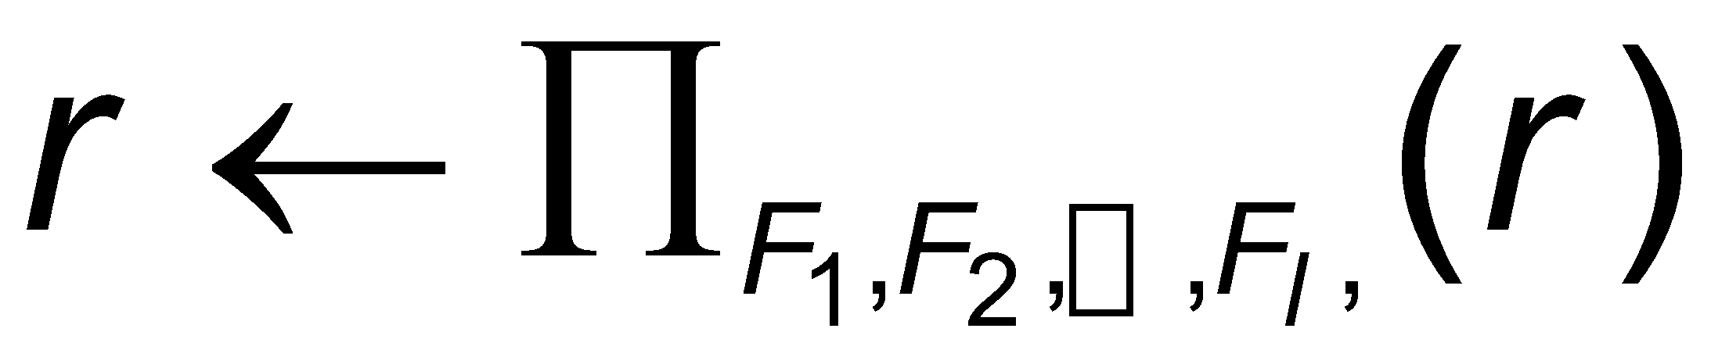
Updating
A mechanism to change a value in a tuple without charging all values in the tuple
Use the generalized projection operator to do this task
Each F_{i} is either
the I ^{th} attribute of r, if the I ^{th} attribute is not updated, or,
if the attribute is to be updated F_{i} is an expression, involving only constants and the attributes of r, which gives the new value for the attribute
Notes:
‹#›

Slide 66
Update Examples
Make interest payments by increasing all balances by 5 percent.
account ← ∏ account_number, branch_name, balance * 1.05 (account)
Pay all accounts with balances over $10,000 6 percent interest and pay all others 5 percent
account ← ∏ account_number, branch_name, balance * 1.06 (σ _{BAL > 10000} (account )) ∪ ∏ account_number, branch_name, balance * 1.05 (σ_{BAL ≤ 10000} (account))
Notes:
‹#›

Slide 67
End
Ch. 10 Storage and File Structure

Slide 68
Division Operator
Given relations r(R) and s(S), such that S ⊂ R, r ÷ s is the largest relation t(R-S) such that t x s ⊆ r
E.g. let r(ID, course_id) = ∏_{ID, course_id} (takes ) and s(course_id) = ∏_{course_id} (σ_{dept_name=“Biology”}(course ) then r ÷ s gives us students who have taken all courses in the Biology department
Can write r ÷ s as
temp1 ← ∏_{R-S} (r ) temp2 ← ∏_{R-S} ((temp1 x s ) – ∏_{R-S,S} (r )) result = temp1 – temp2
The result to the right of the ← is assigned to the relation variable on the left of the ←
May use variable in subsequent expressions
Notes:
‹#›

Slide 69
Tuple Relational Calculus
Notes:
‹#›

Slide 70
Tuple Relational Calculus
A nonprocedural query language, where each query is of the form
{t | P (t ) }
It is the set of all tuples t such that predicate P is true for t
t is a tuple variable, t [A ] denotes the value of tuple t on attribute A
t ∈ r denotes that tuple t is in relation r
P is a formula similar to that of the predicate calculus
Notes:
‹#›

Slide 71
Predicate Calculus Formula
1. Set of attributes and constants
2. Set of comparison operators: (e.g., <, ≤, =, ≠, >, ≥)
3. Set of connectives: and (∧), or (v)‚ not (¬)
4. Implication (⇒): x ⇒ y, if x if true, then y is true
x ⇒ y ≡ ¬x v y
5. Set of quantifiers:
∃ t ∈ r (Q (t )) ≡ ”there exists” a tuple in t in relation r such that predicate Q (t ) is true
∀t ∈ r (Q (t )) ≡ Q is true “for all” tuples t in relation r
Notes:
‹#›

Slide 72
Example Queries
Find the ID, name, dept_name, salary for instructors whose salary is greater than $80,000
{t | t ∈ instructor ∧ t [salary ] > 80000}
As in the previous query, but output only the ID attribute value
{t | ∃ s ∈ instructor (t [ID ] = s [ID ] ∧ s [salary ] > 80000)}
Notice that a relation on schema (ID) is implicitly defined by
the query
Notes:
‹#›

Slide 73
Example Queries
Find the names of all instructors whose department is in the Watson building
{t | ∃s ∈ instructor (t [name ] = s [name ] ∧ ∃u ∈ department (u [dept_name ] = s[dept_name] “ ∧ u [building] = “Watson” ))}
Find the set of all courses taught in the Fall 2009 semester, or in the Spring 2010 semester, or both
{t | ∃s ∈ section (t [course_id ] = s [course_id ] ∧ s [semester] = “Fall” ∧ s [year] = 2009 v ∃u ∈ section (t [course_id ] = u [course_id ] ∧ u [semester] = “Spring” ∧ u [year] = 2010)}
Notes:
‹#›

Slide 74
Example Queries
Find the set of all courses taught in the Fall 2009 semester, and in the Spring 2010 semester
{t | ∃s ∈ section (t [course_id ] = s [course_id ] ∧ s [semester] = “Fall” ∧ s [year] = 2009 ∧ ∃u ∈ section (t [course_id ] = u [course_id ] ∧ u [semester] = “Spring” ∧ u [year] = 2010)}
Find the set of all courses taught in the Fall 2009 semester, but not in the Spring 2010 semester
{t | ∃s ∈ section (t [course_id ] = s [course_id ] ∧ s [semester] = “Fall” ∧ s [year] = 2009 ∧ ¬ ∃u ∈ section (t [course_id ] = u [course_id ] ∧ u [semester] = “Spring” ∧ u [year] = 2010)}
Notes:
‹#›

Slide 75
Safety of Expressions
It is possible to write tuple calculus expressions that generate infinite relations.
For example, { t | ¬ t ∈ r } results in an infinite relation if the domain of any attribute of relation r is infinite
To guard against the problem, we restrict the set of allowable expressions to safe expressions.
An expression {t | P (t )} in the tuple relational calculus is safe if every component of t appears in one of the relations, tuples, or constants that appear in P
NOTE: this is more than just a syntax condition.
E.g. { t | t [A] = 5 ∨ true } is not safe --- it defines an infinite set with attribute values that do not appear in any relation or tuples or constants in P.
Notes:
‹#›

Slide 76
Universal Quantification
Find all students who have taken all courses offered in the Biology department
{t | ∃ r ∈ student (t [ID] = r [ID]) ∧ (∀ u ∈ course (u [dept_name]=“Biology” ⇒ ∃ s ∈ takes (t [ID] = s [ID ] ∧ s [course_id] = u [course_id]))}
Note that without the existential quantification on student, the above query would be unsafe if the Biology department has not offered any courses.

Slide 77
Domain Relational Calculus
Notes:
‹#›

Slide 78
Domain Relational Calculus
A nonprocedural query language equivalent in power to the tuple relational calculus
Each query is an expression of the form:
{ < x₁, x₂, …, x_{n} > | P (x₁, x₂, …, x_{n})}
x₁, x₂, …, x_{n} represent domain variables
P represents a formula similar to that of the predicate calculus
Notes:
‹#›

Slide 79
Example Queries
Find the ID, name, dept_name, salary for instructors whose salary is greater than $80,000
{< i, n, d, s> | < i, n, d, s> ∈ instructor ∧ s > 80000}
As in the previous query, but output only the ID attribute value
{< i> | < i, n, d, s> ∈ instructor ∧ s > 80000}
Find the names of all instructors whose department is in the Watson building
{< n > | ∃ i, d, s (< i, n, d, s > ∈ instructor ∧ ∃ b, a (< d, b, a> ∈ department ∧ b = “Watson” ))}
Notes:
‹#›

Slide 80
Example Queries
Find the set of all courses taught in the Fall 2009 semester, or in the Spring 2010 semester, or both
{<c> | ∃ a, s, y, b, r, t ( <c, a, s, y, b, t > ∈ section ∧ s = “Fall” ∧ y = 2009 ) v ∃ a, s, y, b, r, t ( <c, a, s, y, b, t > ∈ section ] ∧ s = “Spring” ∧ y = 2010)}
This case can also be written as {<c> | ∃ a, s, y, b, r, t ( <c, a, s, y, b, t > ∈ section ∧ ( (s = “Fall” ∧ y = 2009 ) v (s = “Spring” ∧ y = 2010))}
Find the set of all courses taught in the Fall 2009 semester, and in the Spring 2010 semester
{<c> | ∃ a, s, y, b, r, t ( <c, a, s, y, b, t > ∈ section ∧ s = “Fall” ∧ y = 2009 ) ∧ ∃ a, s, y, b, r, t ( <c, a, s, y, b, t > ∈ section ] ∧ s = “Spring” ∧ y = 2010)}
Notes:
‹#›

Slide 81
Safety of Expressions
The expression:
{ < x₁, x₂, …, x_{n} > | P (x₁, x₂, …, x_{n} )}
is safe if all of the following hold:
All values that appear in tuples of the expression are values from dom (P ) (that is, the values appear either in P or in a tuple of a relation mentioned in P ).
For every “there exists” subformula of the form ∃ x (P₁(x )), the subformula is true if and only if there is a value of x in dom (P₁) such that P₁(x ) is true.
For every “for all” subformula of the form ∀_{x} (P₁ (x )), the subformula is true if and only if P₁(x ) is true for all values x from dom (P₁).
Notes:
‹#›

Slide 82
Universal Quantification
Find all students who have taken all courses offered in the Biology department
{< i > | ∃ n, d, tc ( < i, n, d, tc > ∈ student ∧ (∀ ci, ti, dn, cr ( < ci, ti, dn, cr > ∈ course ∧ dn =“Biology” ⇒ ∃ si, se, y, g ( <i, ci, si, se, y, g> ∈ takes ))}
Note that without the existential quantification on student, the above query would be unsafe if the Biology department has not offered any courses.
* Above query fixes bug in page 246, last query

Slide 83
Modification of the Database
The content of the database may be modified using the following operations:
Deletion
Insertion
Updating
All these operations can be expressed using the assignment operator
Notes:
‹#›

Slide 84
Deletion
A delete request is expressed similarly to a query, except instead of displaying tuples to the user, the selected tuples are removed from the database
Can delete only whole tuples; cannot delete values on only particular attributes
A deletion is expressed in relational algebra by:
r ← r – E
where r is a relation and E is a relational algebra query
Notes:
‹#›

Slide 85
Deletion Examples
Delete all account records in the Perryridge branch.
account ← account – σ _{branch_name = “Perryridge”} (account )
Delete all loan records with amount in the range of 0 to 50
loan ← loan – σ _{amount ≥ 0 and amount ≤ 50} (loan)
Delete all accounts at branches located in Needham.
r₁ ← σ _{branch_city = “Needham”} (account branch )
r₂ ← ∏ _{account_number,} _{branch_name, balance} (r₁)
r₃ ← ∏ _{customer_name, account_number} (r₂ depositor)
account ← account – r₂
depositor ← depositor – r₃
Notes:
‹#›

Slide 86
Insertion
To insert data into a relation, we either:
specify a tuple to be inserted
write a query whose result is a set of tuples to be inserted
in relational algebra, an insertion is expressed by:
r ← r ∪ E
where r is a relation and E is a relational algebra expression.
The insertion of a single tuple is expressed by letting E be a constant relation containing one tuple.
Notes:
‹#›

Slide 87
Insertion Examples
Insert information in the database specifying that Smith has $1200 in account A-973 at the Perryridge branch.
account ← account ∪ {(“A-973”, “Perryridge”, 1200)}
depositor ← depositor ∪ {(“Smith”, “A-973”)}
Provide as a gift for all loan customers in the Perryridge branch, a $200 savings account. Let the loan number serve as the account number for the new savings account.
r₁ ← (σ_{branch_name = “Perryridge”} (borrower loan))
account ← account ∪ ∏_{loan_number, branch_name, 200} (r₁)
depositor ← depositor ∪ ∏_{customer_name, loan_number} (r₁)
Notes:
‹#›

Slide 88
Updating
A mechanism to change a value in a tuple without charging all values in the tuple
Use the generalized projection operator to do this task
Each F_{i} is either
the I ^{th} attribute of r, if the I ^{th} attribute is not updated, or,
if the attribute is to be updated F_{i} is an expression, involving only constants and the attributes of r, which gives the new value for the attribute
Notes:
‹#›

Slide 89
Update Examples
Make interest payments by increasing all balances by 5 percent.
account ← ∏ account_number, branch_name, balance * 1.05 (account)
Pay all accounts with balances over $10,000 6 percent interest and pay all others 5 percent
account ← ∏ account_number, branch_name, balance * 1.06 (σ _{BAL > 10000} (account )) ∪ ∏ account_number, branch_name, balance * 1.05 (σ_{BAL ≤ 10000} (account))
Notes:
‹#›

Slide 90
Example Queries
Find the names of all customers who have a loan and an account at bank.
∏_{customer_name} (borrower) ∩ ∏_{customer_name} (depositor)
Find the name of all customers who have a loan at the bank and the loan amount
∏customer_name, loan_number, amount (borrower loan)
Notes:
‹#›

Slide 91
Example Queries
Find all customers who have an account from at least the “Downtown” and the Uptown” branches.
Query 1
∏_{customer_name} (σ_{branch_name = “Downtown”} (depositor account )) ∩
∏_{customer_name} (σ_{branch_name = “Uptown”} (depositor account))
Query 2
∏_{customer_name, branch_name} (depositor account) ÷ ρ_{temp(branch_name)} ({(“Downtown” ), (“Uptown” )})
Note that Query 2 uses a constant relation.
Notes:
‹#›

Slide 92
Bank Example Queries
Find all customers who have an account at all branches located in Brooklyn city.
∏_{customer_name, branch_name} (depositor account) ÷ ∏_{branch_name} (σ_{branch_city = “Brooklyn”} (branch))
Notes:
‹#›

Slide 93
End of Chapter 6

Slide 94
http://users.cms.caltech.edu/~donnie/cs121/CS121Lec02.pdf
http://www.inf.unibz.it/~nutt/Teaching/IDBs0910/IDBExercises/4-sol-relAlg.pdf
http://cir.dcs.uni-pannon.hu/cikkek/DB_relational_algebra_v2.pdf
https://www.inf.usi.ch/faculty/soule/teaching/2014-spring/04_Relational_Algebra_With_SQL_Equivalents.pdf
http://users.cms.caltech.edu/~donnie/cs121/CS121Lec03.pdf
https://www.cs.cornell.edu/projects/btr/bioinformaticsschool/slides/gehrke.pdf
http://www.cs.toronto.edu/~faye/343/f07/lectures/wk3/03_RAlgebra.pdf

